Slide 1
1302493 Software Development and Documentation Documentation in the Design Phase Dr. Sharefa Murad 2023/2024

Slide 2
System Design Document
Specifies the construction details of the system, each system component’s interaction with other components and external systems, and the interface that allows end users to operate the system and its functions

Slide 3
Design
Data Design
Data Models
ERD
UI Design
Site Map/ App Map
Wireframe
Mock-up
Prototype
Architectural Design
Medium and Low-Level UML Diagrams

Slide 4
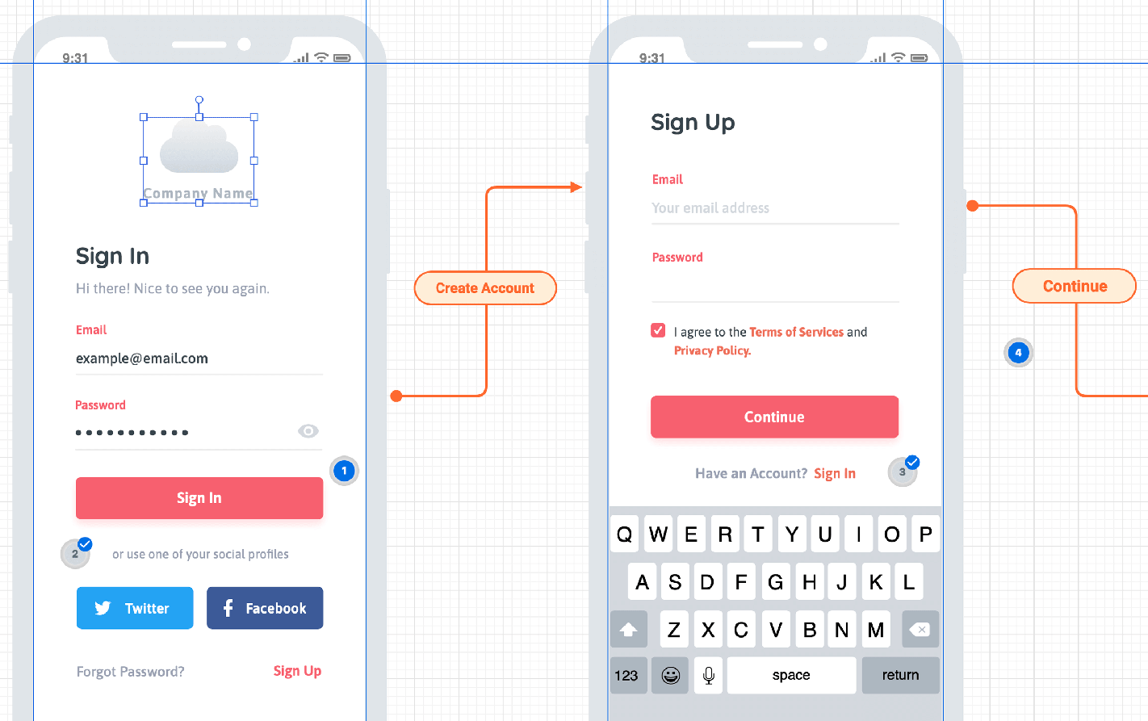
Wireframing: The Blueprint of UI Design
Wireframing as the initial step in UI design.
Wireframes are low-fidelity, simplified representations of the user interface.
Wireframes focus on structure and layout, helping to visualize the content's placement.
Notes:
The practice of creating wireframes, which are low-fidelity, simplified representations of a user interface.
Wireframes serve as a visual guide that outlines the basic structure and layout of a digital product, such as a website or mobile app, without getting into detailed design elements like colors, typography, or images.

Slide 5
How to Wireframing:
Define Goals and Requirements
Research and Gather Information
Identify Key Elements
Sketch Initial Ideas
Create Digital Wireframes
Establish Hierarchy and Flow
Iterate and Refine
Annotate and Document
Test the Wireframe
Handoff to Design and Development
Notes:
wireframing is an iterative process, and it's essential to involve stakeholders and gather feedback throughout the process to ensure the final product meets user needs and business objectives.

Slide 6
Tools for Digital Wireframes
Sketch: Sketch is a powerful digital design tool primarily used for UI and UX design. It offers a wide range of features, including symbols and reusable components, making it suitable for wireframing.
Adobe XD: Adobe XD is a vector-based design tool that allows you to create wireframes, prototypes, and designs in one application. It offers features like interactive prototypes and real-time collaboration.
Figma: Figma is a cloud-based design tool that enables real-time collaboration among team members. It's suitable for wireframing, prototyping, and design systems.
Balsamiq: Balsamiq is a user-friendly wireframing tool that focuses on simplicity and rapid wireframing. It offers a library of pre-built UI components and sketch-style wireframes.
Axure RP: Axure RP is a comprehensive prototyping tool that allows you to create wireframes, prototypes, and specifications. It offers advanced interactions and dynamic content capabilities.

Slide 7
Tools for Digital Wireframes
Moqups: Moqups is an online wireframing and mockup tool with a simple drag-and-drop interface. It offers a wide range of pre-built templates and UI components.
InVision: InVision is primarily known for its prototyping capabilities but also offers basic wireframing tools. It allows you to create interactive prototypes and gather feedback from stakeholders.
Wireframe.cc: Wireframe.cc is a minimalistic online wireframing tool that focuses on simplicity and speed. It's suitable for creating quick wireframes without distractions.
Lucidchart: Lucidchart is a versatile diagramming tool that can be used for wireframing, flowcharts, and other visualizations. It offers collaboration features and integrations with other tools.
Pen and Paper: Sometimes, a simple pen and paper can be the most effective wireframing tool, especially for quick sketches and brainstorming sessions.

Slide 8
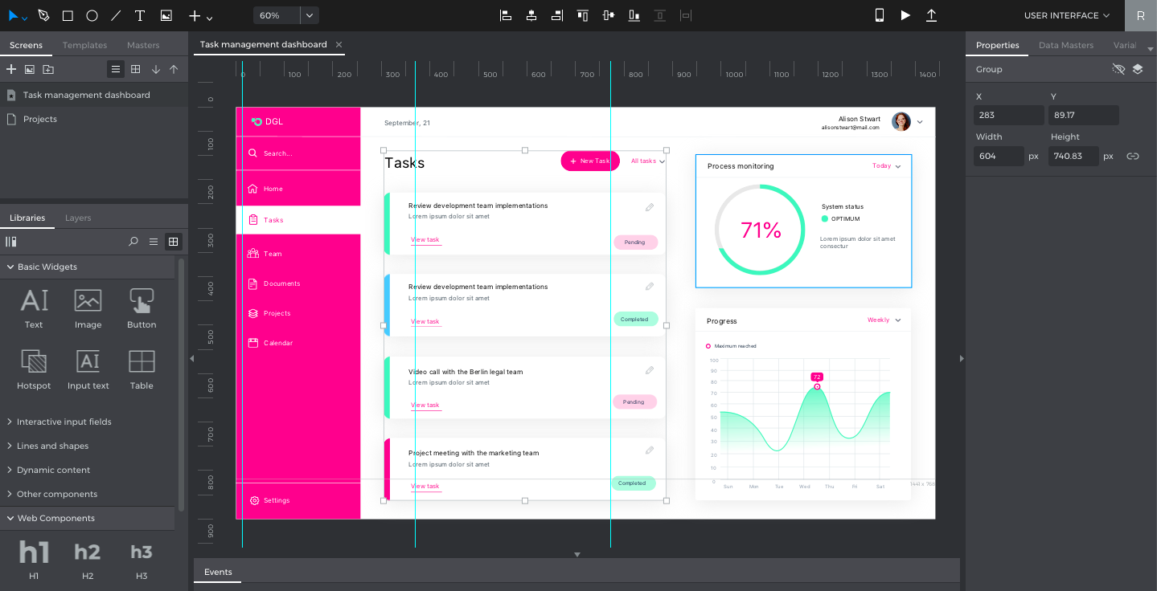
Mockups: Bringing UI Design to Life
Mockups as more detailed visual representations of the user interface.
Mockups add color, typography, and basic visual elements.
The use of mockups is to showcase the design’s details and overall look and feel.

Slide 9
Mockups
Mockups are static representations or visualizations of a design, typically used to showcase the appearance and layout of a digital product, such as a website, mobile app, or software interface. Mockups provide a more detailed and realistic depiction compared to wireframes, as they include visual elements such as colors, typography, and imagery.
They help stakeholders, clients, and team members visualize the final product and provide feedback on its aesthetics and overall design direction.
Mockups can be created using graphic design software, prototyping tools, or even by hand sketching. They play a crucial role in the design process, allowing designers to iterate and refine the visual aspects of a project before proceeding to the development stage.

Slide 10
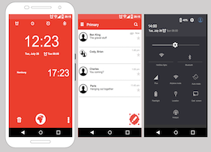
Prototyping: Interactive User Experience Preview
Introduce prototypes as interactive representations of the user interface.
Explain that prototypes allow users to interact with the design, providing a sense of functionality.
Highlight the value of prototypes in user testing and feedback collection.

Slide 11
Prototyping Tools
Principle: Principle is a macOS application for designing interactive prototypes with animations and transitions. It offers an intuitive timeline-based interface for creating complex interactions.
Origami Studio: Origami Studio is a prototyping tool developed by Facebook that allows you to create interactive prototypes with animations and gestures. It's suitable for designing mobile app prototypes.
Balsamiq: Balsamiq is a wireframing and prototyping tool that focuses on simplicity and rapid prototyping. It's suitable for creating low-fidelity prototypes with a sketch-like appearance.
Marvel: Marvel is a prototyping tool that offers features for designing, prototyping, and user testing. It's known for its simplicity and ease of use, making it suitable for rapid prototyping.
Proto.io: Proto.io is a user-friendly prototyping tool that allows you to create interactive prototypes without writing any code. It offers a wide range of UI components, animations, and gestures.

Slide 12
Practice
Create wireframe and mockups using Draw.io

